Slide 1

Class 4 Welcome Evening
Our aims, expectations and overview of the exciting year ahead!
Notes:
LP

Slide 2
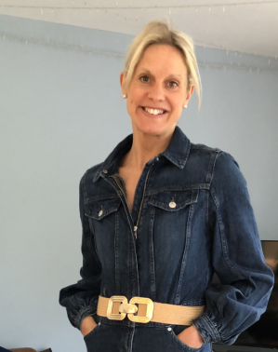
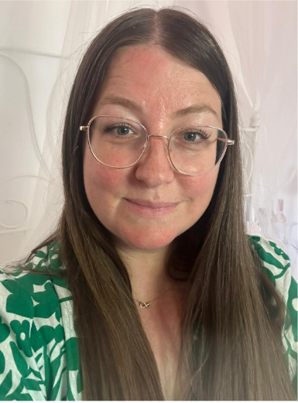
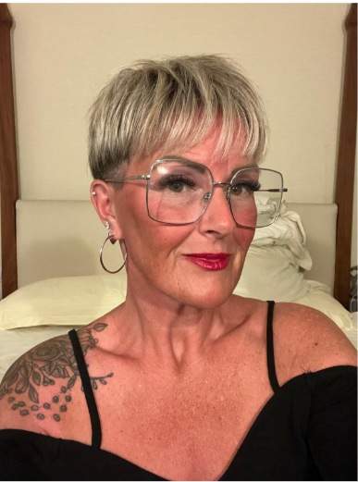
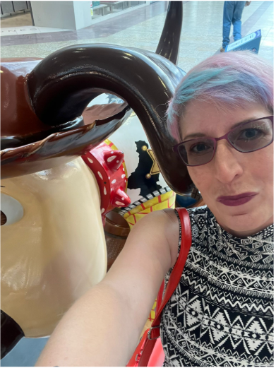
Who’s Who in Class 4
Everyday – Mrs Jackson
Every morning – Mrs Adams
Monday and Tuesday – Mrs HC
Wednesday –Mrs Morgan/Mrs HC/Mr Tillie
Thursday and Friday – Mrs Morgan
Mrs HC Mrs Morgan Mrs Jackson Mrs Adams

Slide 3

Our Vision for an exciting year ahead!
As you know, in all we do, we look to ‘Nurture the Potential for the Brightest Future’. We tell our children that they come to school to ‘Let their Light Shine’ and this feeds into everything we do and every strategic decision we make. We want every child in Class 4 to go beyond their limits and rise to challenges – whether that is academic ones, physical or emotional ones. Every child will be set up for success, but this doesn’t mean it will be easy for them! We want challenges to be a stretch for them and for them to realise…
“Life has no limitations; except the ones you make.” Les Brown
Notes:
LP

Slide 4
Our Values
COMMUNITY | COMMITMENT | COMPASSION | COURAGE
Community
We are a small school with a big heart; a family where every individual is valued and each one belongs.
Commitment
We are committed to nurturing the potential in every child, like a gift waiting to be unwrapped. Our commitment extends beyond the walls of our classrooms, pursuing excellence in all we do.
Compassion
At Malvern Wells, every individual is known, loved, cared for and celebrated. We strive to extend kindness to our school, our community, our nation and our world.
Courage
We are courageous learners, consistently reflecting and constantly improving. We believe that making mistakes is integral to growth, so nurture the curiosity to learn with the freedom to fail, and the passion to make a difference.
Notes:
LP

Slide 5
Behaviour – The Malvern Wells Way
As a staff , in Class 4, we are committed to ensuring that every individual is nurtured to reach their very brightest potential through our safe and nurturing community.
We will do this by generating an environment where exemplary behaviour is the heart of productive learning in our happy classroom. Everyone will be expected to maintain the highest standards of personal conduct, to accept responsibility for their behaviour and to encourage others to do the same.
We recognise that good behaviour is rooted in strong relationships and our vision and values are central to promoting relationships and setting the culture of our school. We define culture at Malvern Wells as: ‘The way we do things around here… even when no one is looking.’
Our behaviour choices are rooted in exemplifying our 4 values through our school.
For more information so see our Behaviour and Relationships Policy on our website.
Notes:
LD

Slide 6
Communication in Class 3
Contact the school office with a message
Make an appointment if necessary
Not always available at home time
A Partnership approach
Open and honest communication
Mars
Notes:
Please do talk to us and ask us any q’s or things you might be concerned about (even if you think it’s silly). If you can speak to us at hometime, we will be around (unless we have a mtg)
We understand that it isn’t always easy for you to talk to us especially if you aren’t able to collect your child at 3:30. Therefore, we welcome you to email the office and Julie will pass the message on for you to get back to us. Plus, we’re happy to meet with you if necessary – just ask at hometime or contact the office.

Slide 7







How can you support us to do our best?
Effective Communication is vital! – newsletter, whiteboard, Facebook, texts, emails!
Handbook on website
Read our weekly newsletter
Attend our Best Seats Assembly when you can
Communicate with us – good and arising needs
Attend parents' evenings, workshops and other supportive events.
Read daily Practice spellings
Tables
Be timely in response and payments – school money
Partner with us to embed our vision and values
Notes:
BP

Slide 8
Home Learning
We love seeing the children's work at home, especially when they are motivated by their learning in school, however, this is not an expectation.
However, we have core 3 focus’ for homework
Reading – please read with your child daily and record this in their personal reading log. They will be checked on a Monday to check they’ve read 5 times a-week.
Spellings – please take time to learn and practise these. Given out on a Friday and tested on a Friday.
TTRS – 15 minutes a-week. Weekly challenges set.
Extra - Key words to practice
Practise SATs papers taken home from January

Slide 9
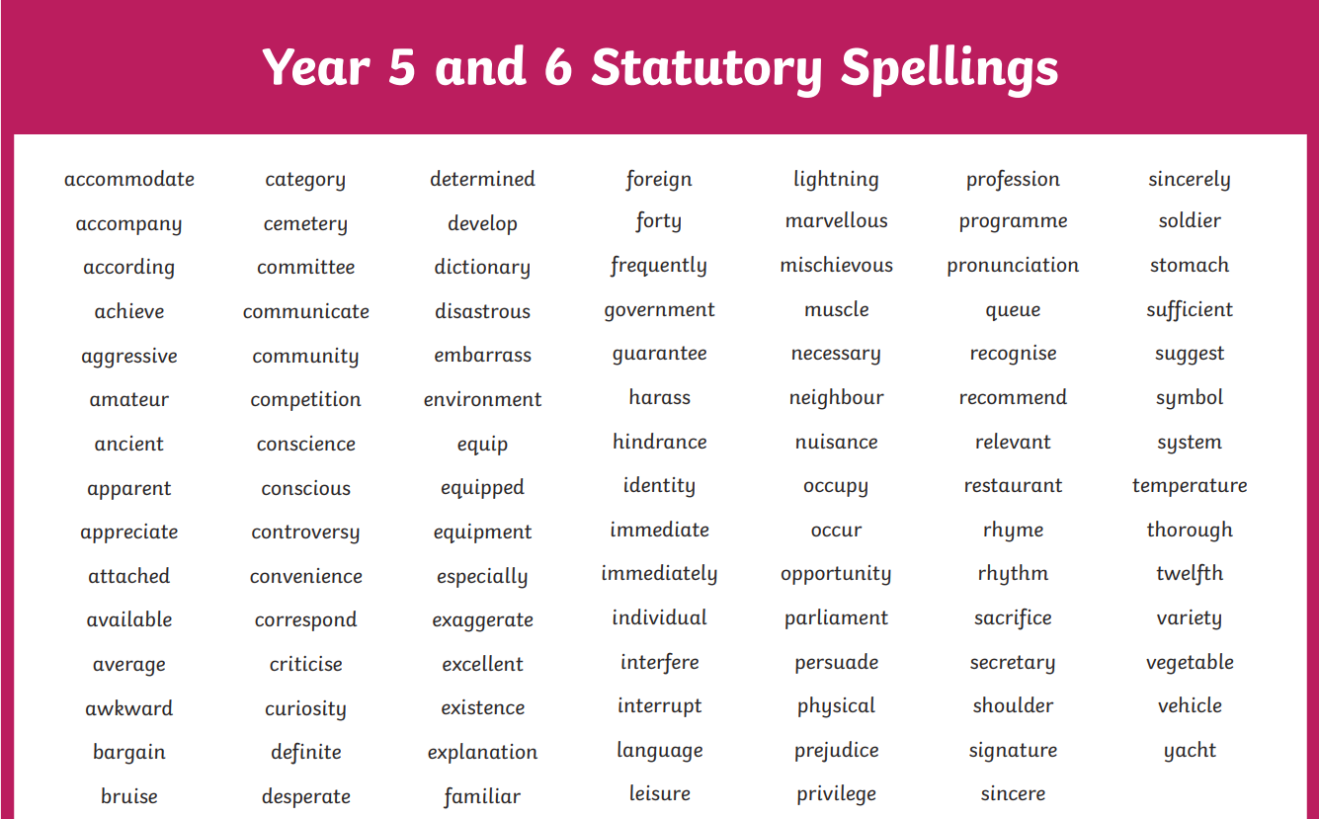

Slide 10
What are we learning about this term?
Science
Forces
History
How did England change during the settlement of the Anglo-Saxons?
PE
Wednesday afternoons – Charlie Tillie
PE clothes
Art
Monochromatic
How can we find our own style of drawing?
RE – Creation and Science: Conflict or complementary?
Forest School
Every other Tuesday
Forest school clothers
Pick up from NR
PSCHE
Jigsaw with Mrs Jackson &Miss Spilsbury
Notes:
BP

Slide 11
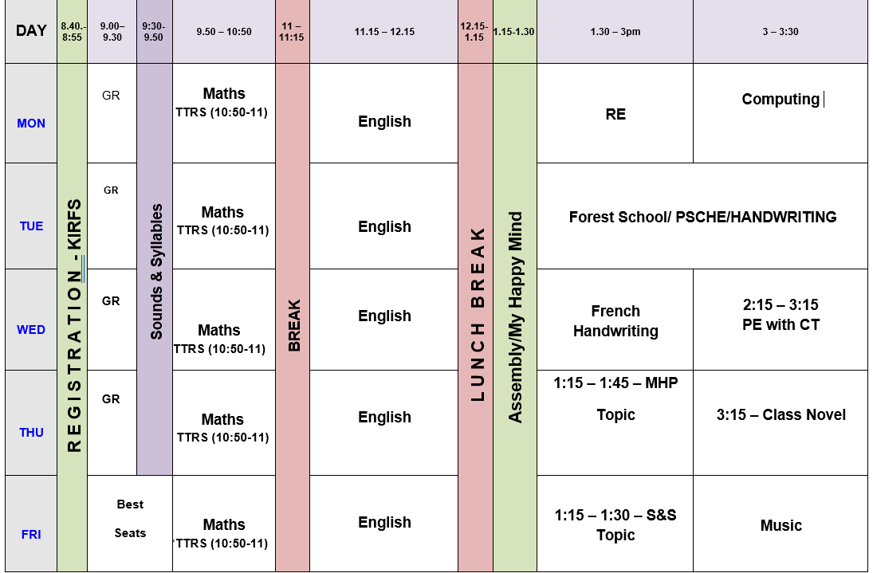
Autumn Term Timetable
3D curriculum – linked, sequenced blocked subjects

Slide 12

Maths
We teach maths using a mastery approach. We use a range of resources.
We always start the year with place value to assess the children's number knowledge and build on this across the year.
Each morning, we complete KIRFS to support the children’s rapid recall of number facts. We use Can Do Maths and split the year groups.
Notes:
SP

Slide 13
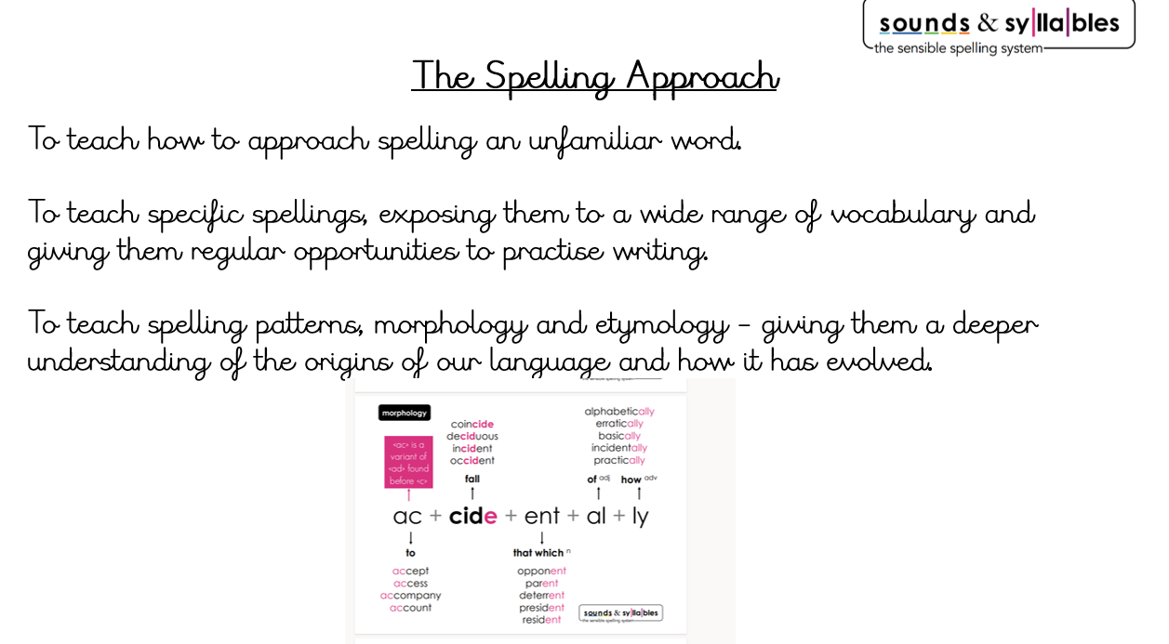

Slide 14
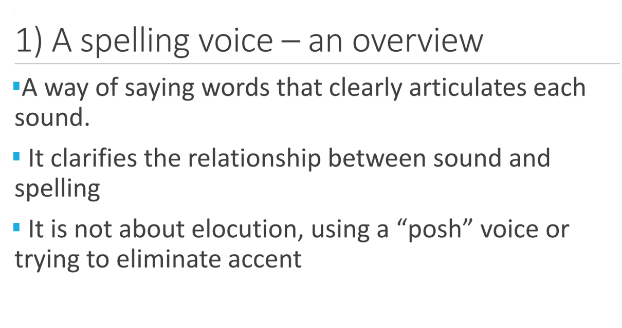

Slide 15
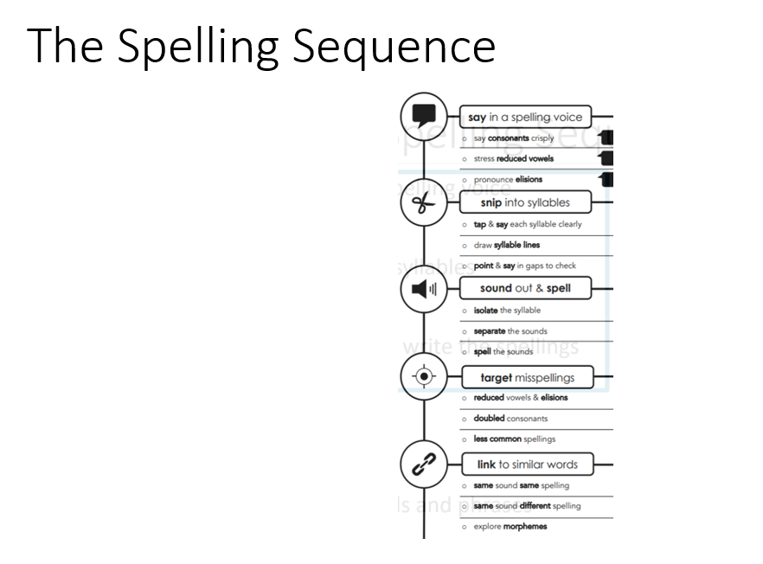

Slide 16

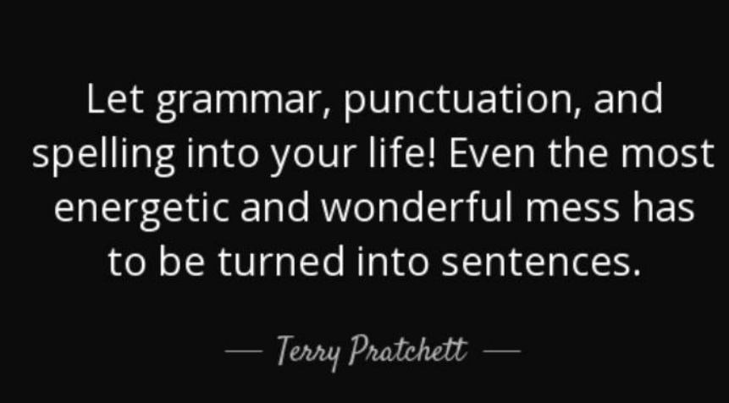
Writing
We take a sequenced approach to Writing and plan through ‘Talk for Writing.’This isn’t a scheme it is a writing framework which give the children the tools to become independent writers.
They are assessed regularly through Hot Task pieces of writing – first unit of writing will be focusing on Place Value for Grammar to embed the basics.
Notes:
SP

Slide 17


How can you help your child be a successful writer?
Read as much as possible to immerse them and expose them in high quality language and vocabulary. Children will not be able to write it if they can’t say it.
Year 5 | Year 6

Slide 18

Improve the Word

Slide 19
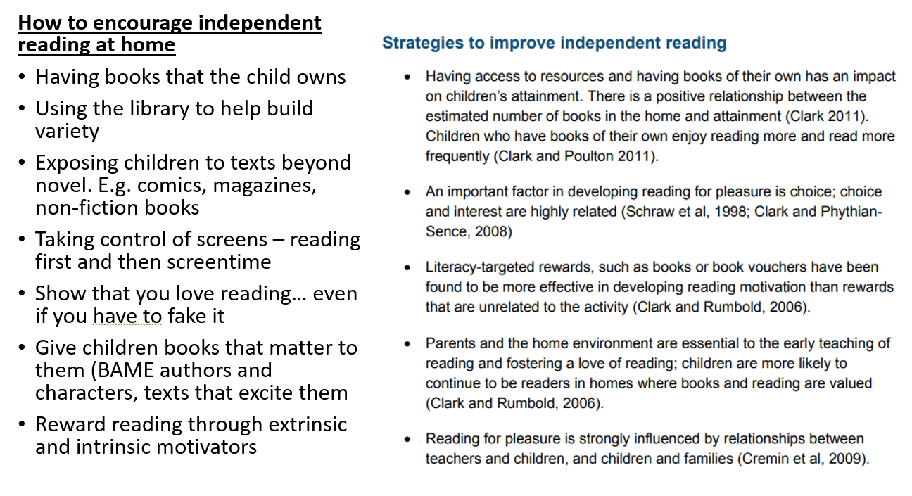
My child is a good reader, what happens next?

Slide 20
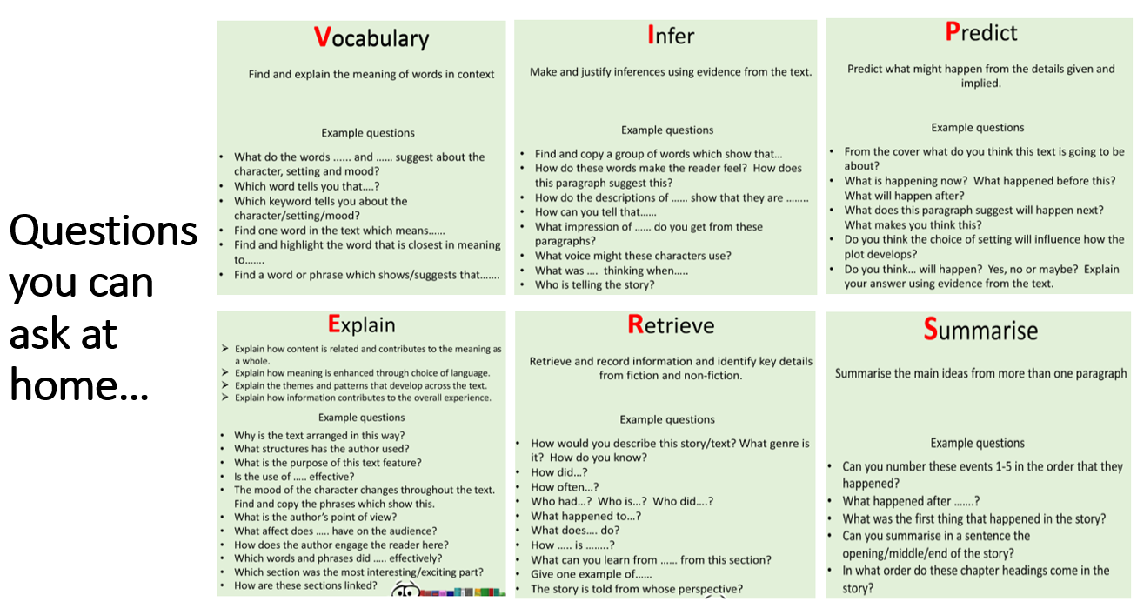

Slide 21
Online Safety
The best filter is an educated child
Children have the right to enjoy childhood online, to access safe online spaces, and to benefit from all the opportunities that a connected world can bring to them, appropriate to their age and stage.
As they grow older, it is crucial that they learn to balance the benefits offered by technology with a critical awareness of their own and other’s online behaviour and develop effective strategies for staying safe and making a positive contribution online.
UK Council for Internet Safety
Notes:
LP

Slide 22
Online Safety
At School
Safe and responsible use of the Internet is at the heart of our school curriculum.
Clear expectations are set through the school’s online safety policy and acceptable use agreements.
Online safety issues are taken seriously and are monitored to inform the computing curriculum.
Opportunities for teaching about online safety issues are identified in other areas of the curriculum.
At Home
Reinforce the messages shared through the acceptable use agreements.
Monitor what your child is viewing on the Internet and have open discussions about who they are communicating with.
Set clear boundaries regarding who they can communicate with (i.e. only people that they know in the real world) and how much time that they spend on the computer or tablet.
Notes:
LP

Slide 23

Key Trips
Autumn 1 | Autumn 2 | Spring 1
Tuesday 16th September – Think Tank | Swimming TBC | 9th February – Geography Walk to St Wulstans Nature Reserve

Slide 24

THANK YOU FOR YOUR CONTINUED SUPPORT
Notes:
SP

