Slide 1

Year 3 & 4 Curriculum
Presentation
2025-2026

Slide 2
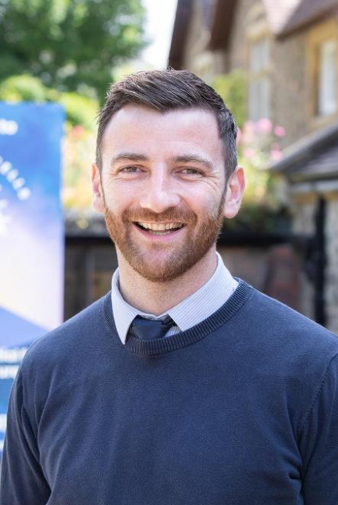
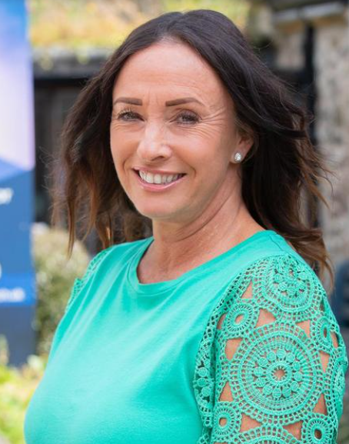
Meet the Team!
Our Class is called Class 3
Teachers:- Mr Boyle
Teaching Assistants: Mrs Spilsbury

Slide 3
Our Vision and Values
Our vision, each day, is to 'nurture the potential for an even brighter future.'
‘You are the light of the world – like a town on a hilltop that cannot be hidden’. Matthew 5v14
We aspire for everyone at Malvern Wells to be the BRIGHTEST version of themselves, equipped with the knowledge that they are unconditionally loved by God who sees their intrinsic value, free to take risks, make mistakes and grow in the safety of his forgiveness ready for the plans and purposes He has in store for their bright future.
Let YOUR Light Shine by Letting His Light Shine through You!
We really believe every child CAN shine brightly and we are committed to helping them find the connections required to do so.

Slide 4
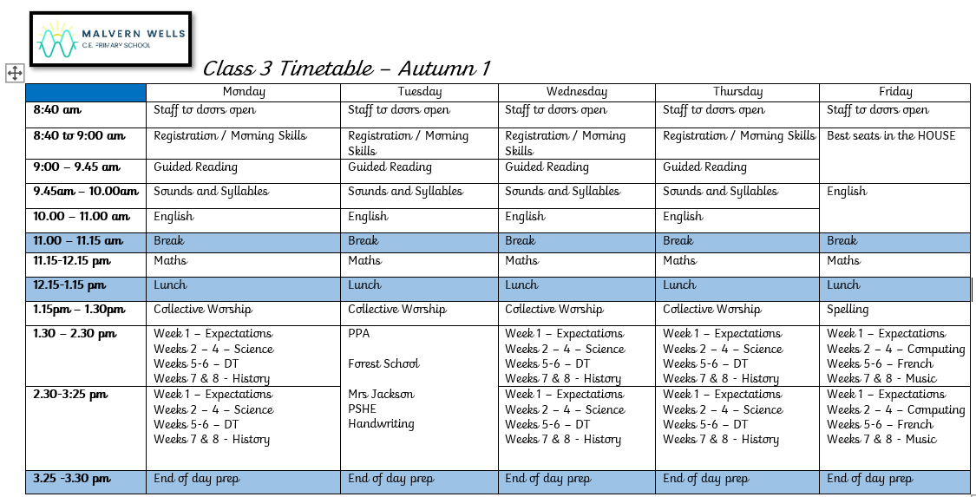
Structure of the day…

Slide 6
How will we communicate with you?
We believe that clear, open communication between the school and parents/carers has a positive impact on students’ learning because it:
• Gives parents/carers the information they need to support their child’s education
• Helps the school improve, through feedback and consultation with parents/carers
• Builds trust between home and school, which helps the school better support each student’s educational and pastoral needs
Parents should monitor all of the following avenues of communication regularly to make sure they do not miss important communications or announcements that may affect their child.
Email – including T2P
Text Messages
School Calendar
Phone Calls
Weekly Newsletter
Parents Evenings
Annual Reports
We are available for a chat after the school day, so please do come and grab us!

Slide 7
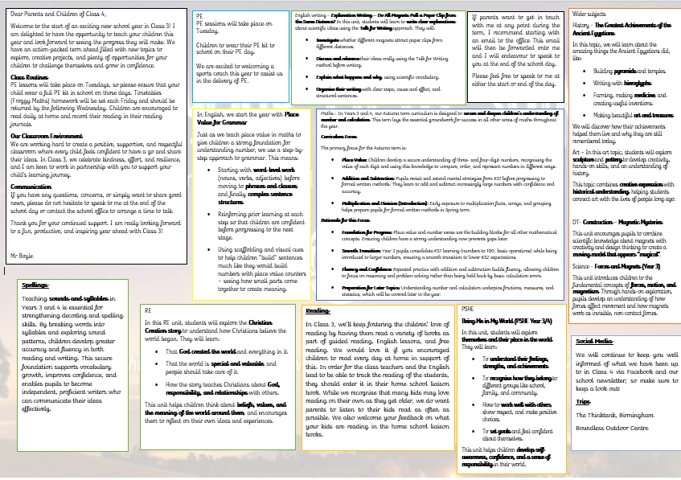
Curriculum
Autumn Term

Slide 8
The Broader Curriculum
Our curriculum is built around children acquiring knowledge and skills linked to subject specificity.
New knowledge learnt is cemented together with advanced subject specific skills.
The knowledge is then retrieved throughout the curriculum as it is planned to interleave in the following years. It is centred around a big enquiry question in either Geography or History, with cross-curricular links forged to create engaging and relevant learning contexts to ensure children know more and remember more.
Our big concepts that run throughout our history and geography are society/community, exploration and invasion, power, conflict and disaster.
The curriculum will be delivered in subject blocks this year to support the acquisition of knowledge and retrieved through guided reading.

Slide 9
Any questions?

Slide 10
How can I support my child at home?
As your child progresses through Year 5 and Year 6, it is important to continue supporting their learning at home. Here are some helpful tips on how you can assist your child with their education outside of the classroom:
Establish a Routine: Encourage your child to set aside specific times for homework and revision. Creating a consistent routine can help them stay organised and focused.
Provide a Quiet Study Space: Designate a quiet and well-lit area for your child to concentrate on their schoolwork. A comfortable workspace can enhance their productivity.
Encourage Reading: Foster a love for reading by providing a variety of books that cater to your child's interests. Reading regularly can improve their literacy skills and broaden their knowledge.
Support Curiosity: Encourage your child to ask questions and explore topics that interest them. Engaging in discussions and seeking answers together can deepen their understanding of various subjects.
Monitor Progress: Regularly check in with your child about their schoolwork and academic progress. Celebrate their achievements and offer support if they are facing challenges.
By actively engaging in your child's education at home, you can reinforce their classroom learning and help them succeed academically.

Slide 11

Any questions?

